Slide 1
GREECE AND PANAMA: A SPECIAL RELATIONSHIP
A study conducted for
“DIKTIO – Network for Reform in Greece and Europe”
by
THANOS PALLIS
Department of Maritime Studies, University of Piraeus
GEORGE VAGGELAS
Department of Shipping Trade and Transport, University of the Aegean
&
EVIE KLADAKI
Department of Shipping Trade and Transport, University of the Aegean
ECONOMIC AND MARITIME LINKS BETWEEN GREECE AND PANAMA
THANOS PALLIS
Department of Maritime Studies, University of Piraeus &
President of the International Association of Maritime Economists (IAME)
May 2022

Slide 2
Cultural ties between Greece & Panama
16th Century
1903 to 1914
1969 to 1978
Greek emigration in Panama begins.
2nd movement with builders.
A Greek President of Panama, Demitrios B. Lakas Bahas, with Carlos Ozores Typaldos serving as the vice-president
Cpt. Maurakis: the one who crossed for the first time the Panama Canal, in 1914.
A small yet significant and vibrant Greek community.
Greek builders invited to the construction of the Panama Canal.
A third and fourth wave of Greek diaspora occurs.
Greek school, Instituto Atenea
Late 19th century
1915 and 1930
Today

Slide 3
A Common Maritime Idiosyncrasy
Maritime Country Profiles: Greece & Panama (2020)
Population
10.423.000
Population
4.315.000
Coast/Area Ratio
117,5 m/km2
Coast/Area Ratio
75,8 m/km2
Fleet – Ownership (Dwt)
363.811.000 DWT
Fleet – National Flag (Dwt)
69.019.000 DWT
Fleet – Ownership (Dwt)
1.227.000 DWT
Fleet – National Flag (Dwt)
329.033.000 DWT
GREECE
PANAMA
No. Of Seafarers
30.507
No. Of Seafarers
25.141
Gross Domestic Product (GDP)
189.467.000 USD
Gross Domestic Product (GDP)
52.970.000 USD
Source: Authors, based on UNCTAD data

Slide 4
Greece - Panama bilateral trade, 2010-2020
Bilateral Economic Relations: Bilateral trade
Source: Authors, based World Bank data

Slide 5
Major importing and exporting goods from Panama to Greece
Bilateral Economic Relations: Bilateral trade
PRODUCT
EXPORTS:
GREECE TO PANAMA
IMPORTS:
GREECE FROM PANAMA
VESSELS
CRUDE PETROLEUM
REFINED PETROLEUM
PACKAGED MEDICAMENTS
VESSEL EQUIPMENT
BANANAS
COPER ORE
Source: Authors, based on World Bank data

Slide 6
FDIs: A volatile environment demanding support
Inflows of FDI’s in Panama and the Greek FDI’s in Panama (million US$)
Source: Authors, based on OECD data

Slide 7
Shipping & Maritime Business Relations: Panama and Greece, among the leading registries worldwide
Top Registries (Flags) by Vessel Type (million GT)
Source: Authors, based Clarksons Research data

Slide 8
Shipping & Maritime Business Relations
A STRONG GREEK PRESENCE
GREEKS IN PANAMA:
FLAG REGISTRATIONS
Greek tonnage under the Panama flag:
32.062.217
DWT
Out of the 8.033 vessels that are registered under the flag of Panama at the first quarter of 2022, 545 vessels are of Greek ownership.
PANAMA FLAG
SELECTION
163
Greek Shipowners
A total of 163 Greek shipowners owns one or more ships registered under the flag of Panama.
GREEKS IN PANAMA:
FLAG REGISTRATIONS
PANAMA FLAG
SELECTION
Greek tonnage under the Panama flag compared to the total world tonnage registered, reaches a considerable percentage.
9% of World Total
15%
of total
Greek Shipowners
Greek shipowners that select to register their ships under the flag of Panama reach a considerable percentage.
Source: Authors, based Clarksons Research data

Slide 9
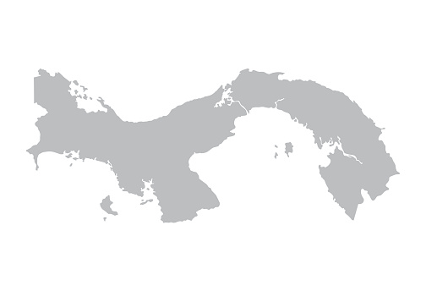
Shipping & Maritime Business Relations: A strong Greek presence
Vessel Calls in Panama Ports per owner nationality, 2019-2022
(Discharge calls, dry Bulk carriers and tankers)
17%
BERMUDA
25%
58%
GREECE
REST OF THE WORLD
Source: Authors, based on Clarksons Research data

Slide 10
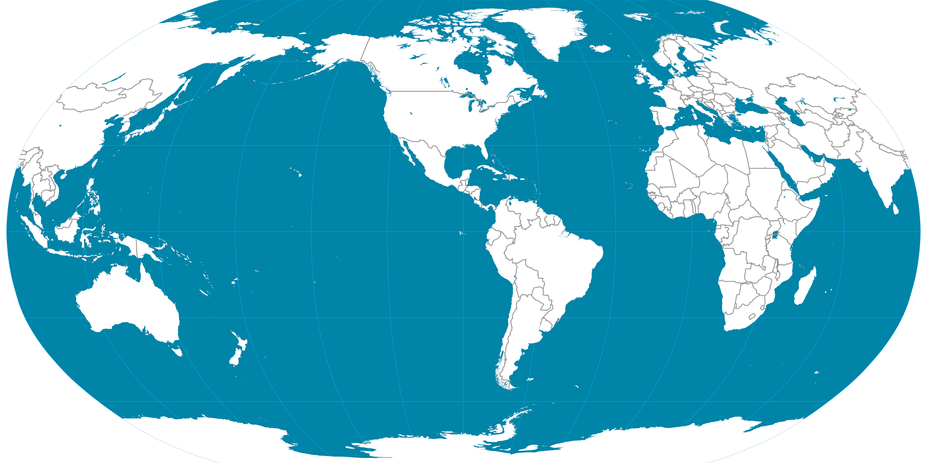
Value Proposition of the Panama Canal: Serving global shipping services
US
West Coast
US
East Coast
7.1 M tons
Europe
78.4 M tons
Asia
WCCA
16.9 M tons
16.1 M tons
37.2 M tons
WCSA
© PEMP

Slide 11
A core policy proposal: The need for a stronger diplomatic mission of Greece in Panama
1
01
WOULD SUPPORT THE ALREADY SIGNIFICANT VALUE OF THE BILATERAL TRADE
2
02
WOULD FACILITATE THE NEEDS OF THE GREEK SHIPPING COMMUNITY
3
03
STRONG EUROPEAN PRESENCE: 4/6 EUROPEAN COUNTRIES WITH THE MOST FDIS IN PANAMA ALREADY OPERATE AN EMBASSY

Slide 12
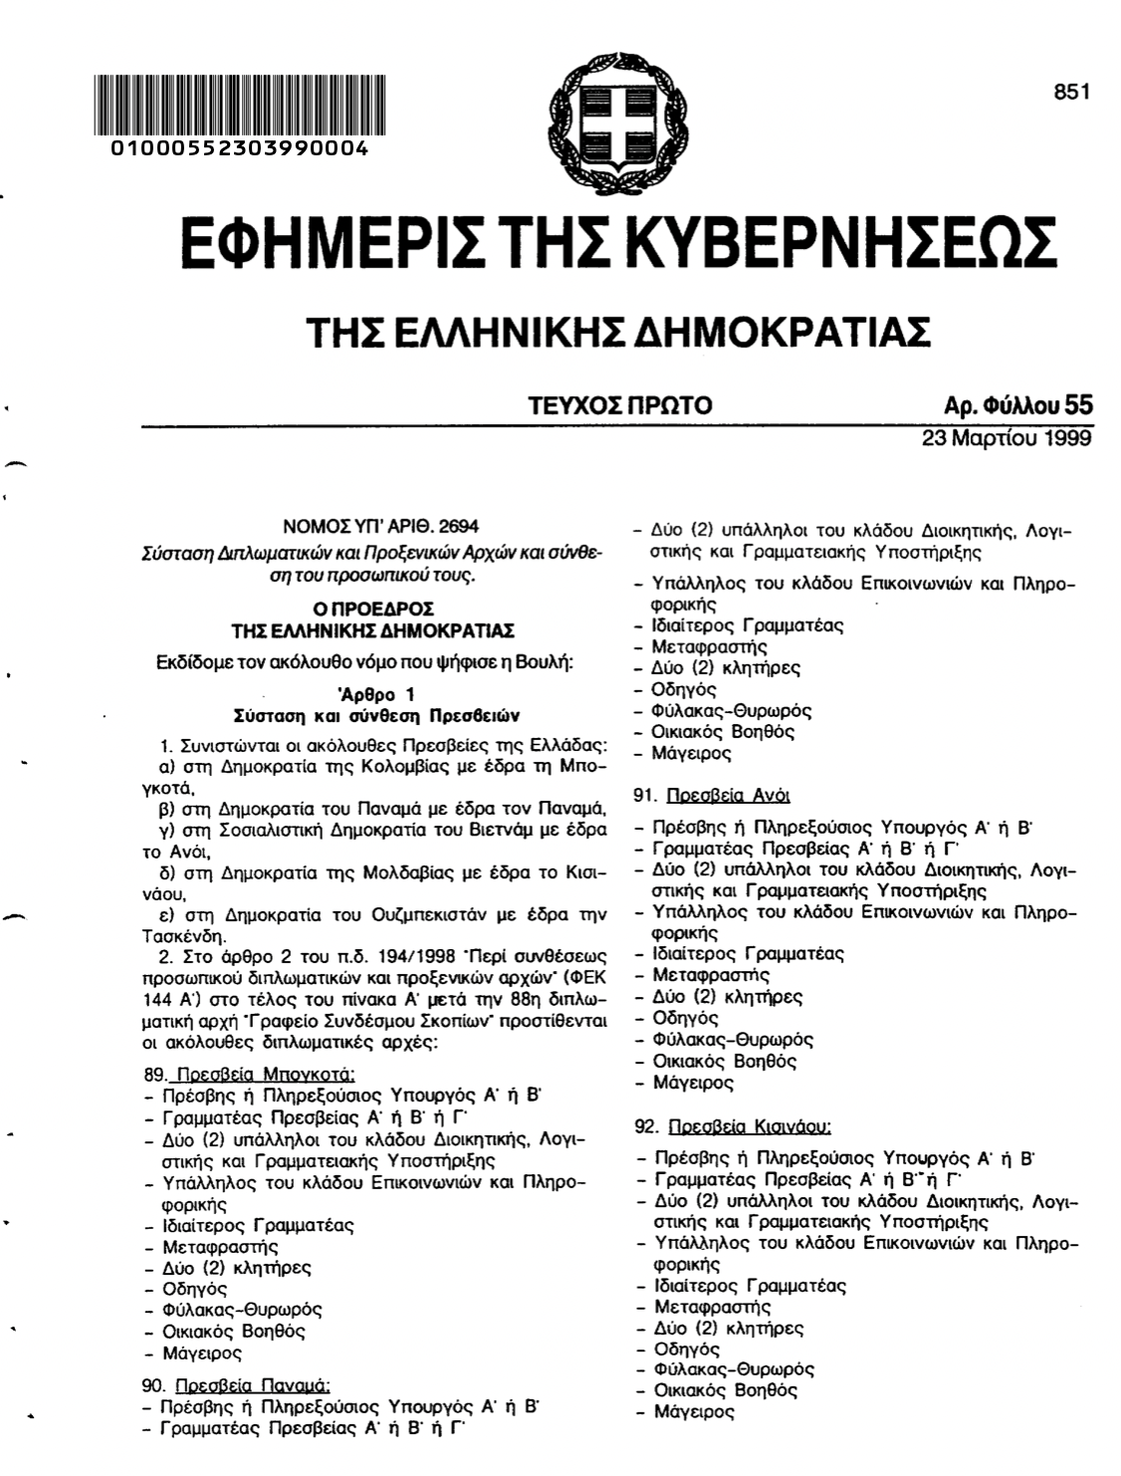
A core policy proposal: Time to implement

